Slide 1
Creating a Subset
Patrick Mathias
Lesson 4
DLMP Core
Notes:
In this session we'll begin to tackle one of the fundamental issues in data analysis and that is the process of transforming, or wrangling, your data set.

Slide 2
Goal
Learn how to use dplyr to transform data frames
Create a smaller subset from a data frame
Objectives
List the major forms of data transformation implemented in dplyr
Use code templates with dplyr functions to tidy a raw data set
Create a subset using logical conditions to extract specific rows from a data frame
Notes:
Our goals for this session are to learn to use some of the functions in the dplyr package to tackle some of the most common challenges in data transformation. In addition we'll be using a special tool called a pipe operator to string together individual functions into a data analysis pipeline.

Slide 3
Typical Data Science Pipeline
Tidy
Transform
Notes:
This is the generalized data science pipeline that was introduced to you yesterday. The functions we'll be learning about fit specifically in the "tidy" and "transform" portions of this workflow.

Slide 4
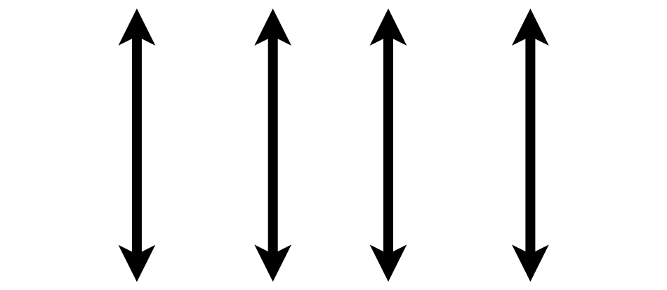

What is a “Tidy” Data Frame
A data set is tidy if:
Each variable is in its own column
Each observation is in its own row
Each value is in its own cell
MRN
Notes:
So let's quickly review what we mean by a tidy dataset. By definition it essentially describes a data set in which
→ variables or features are recorded in columns
→ Each row represents a single observation
→ And finally each cell contains only one value.
This is admittedly somewhat abstract. The way that I think about it is that a tidy data set is one that is at the point where it is cleaned up and ready to be analyzed either using statistical analysis or through a visualization.
The opposite is a messy data frame which is generally how data comes at us in the real world. Its basically in a form that makes it difficult or impossible to analyze without processing.

Slide 5

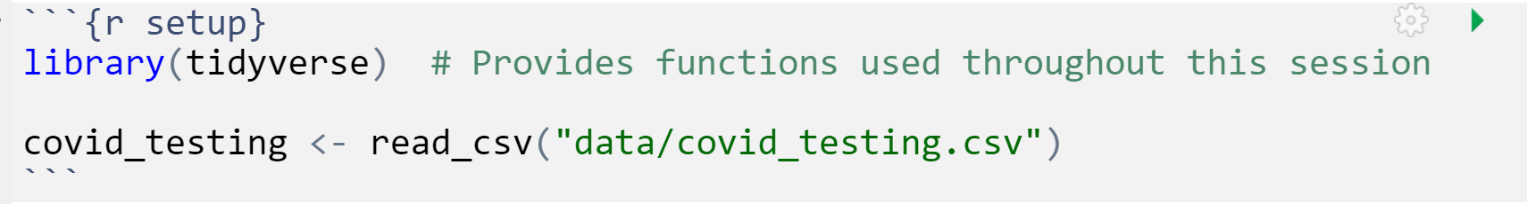
Your Turn 1
Open "04-Subset.Rmd" Run the setup chunk
Notes:
Let's start the session with a Your Turn. Let's head on over to the Cloud Rstudio instance and open the R markdown file called 04-Transform.Rmd and load the covid testing dataset.
(in Rstudio)
This can be done by going to the lower right pane under the "file" tab, navigating to the exercises folder and selecting the 04-Transform.Rmd file.
After that go to the first code chunk which is called "setup" and press the play button

Slide 6

Transform Data with
Notes:
In this session we'll be using functions that are part of the dplyr package. The dplyr package is a workhorse for data transformation and since its part of the tidyverse meta-package you just loaded it with the code chunk from the Your Turn.

Slide 7
dplyr
dplyr implements a grammar for transforming tabular data.
Notes:
Now dplyr isn't just a haphazard collection of functions. It takes a holistic almost philosophical approach to the transformation of data and implements it in an organized lexicon or grammar for programmatically transforming data.
What I mean when I say a grammar for transforming data really relates to 2 characteristics of the dplyr approach.
#1 In a similar way to how verbs operate on nouns, dplyr functions operate on data frames.
#2 Dplyr functions use a consistent syntax which minimizes cognitive load so once you understand the dplyr approach with one function, it's easier to learn new functions in dplyr.

Slide 8
dplyr: a grammar for transforming data
1
Choose columns.
select()
2
Extract rows.
filter()
3
Derive new columns.
mutate()
4
summarize()
Change the unit of analysis.
Notes:
This session is about getting to know these functions. Data wrangling can require a lot of different manipulations and dplyr has a wealth of functions to help you with this, but most data wrangling in my experience will involve one of these four actions
Starting with the raw data, youll need to choose the columns you want, define and extract the rows of interest, you will likely need to derive new calculated columns and finally often we have to aggregate data with a summary.
→
Dplyr implements four functions that handle each of these actions, Select, Filter, Mutate, and Summarize. In this session we'll be discussing the first 3, and the last one will be covered in the next one.

Slide 9
Dplyr Approach
ƒ(
)
Notes:
Another feature of the dplyr approach to data manipulation is that each function in the package is tuned to do one thing, meaning to change the data in one way.
What this means is that if you have several changes you need to make to the dataset - you won't be applying one function to get it to the end result as you see on this slide.

Slide 10
Dplyr Approach
ƒ(
)
ƒ(
)
ƒ(
)
Notes:
Rather a typical workflow involves making one tweak to the data at a time, going through a sequence of steps, each one carried out by one function to get you to the final tidy dataset.

Slide 11
Common syntax
Each function takes a data frame as its first argument and returns a data frame as its output.
function(data, ...)
dplyr function
data frame to transform
specific arguments
11
Notes:
One of the major advantages of using dplyr functions in your data analysis is that dplyr functions all use a common syntax, which makes them easier to learn.
Each one will take a data frame as the first argument, which will be followed by additional arguments that basically serve as instructions to the function on how to operate on the data frame. The output of dplyr functions is always another data frame.

Slide 12
Subset Specific Columns
Notes:
The first set of functions we will explore will be ones whose primary goal is to extracting the data of interest from a large and often messy pile of data.
Reducing a dataset to a narrow subset of columns and rows is often the first step in an analysis.

Slide 13
select()
Extract columns from a data frame
= Number of rows
↓ Number of Columns
Notes:
Here you see the graphical framework for how select works. You provide the raw data as the input in the form of a data frame.
It will extract the columns of your choosing and return these columns as a new data frame.
In the output, you will wind up with all the rows that you started with and just the columns defined in the select function.

Slide 14
select()
Extract columns from a data frame
select(data,... )
select(covid_testing, mrn, last_name)
data frame to transform
name(s) of columns to extract
(or a select helper) function)
dplyr function
data frame to transform
Notes:
So let's take a look at the syntax. You can see here that select() conforms to the syntax of all dplyr functions.
Select takes the starting data frame as its first argument. In this case it’s the "covid_testing" data frame.
After that it takes any number of additional arguments that specify the columns that you want to pick.
In it’s simplest form, those additional arguments will just be the names of the columns that you want to select. For example in this case we are indicating that we want to keep the mrn and last_name columns.
In very wide datasets, writing out the names of the columns you want just doesn’t scale so dplyr does have additional convenience functions that can help you succinctly identify the columns you want. We won't go over these together but they can be found in the data transformation cheat sheet in the appendix to your coursebook.

Slide 15
select()
Extract columns from a data frame by name
select(covid_testing, mrn, last_name)
covid_testing
description | department
PROTHROMBIN TIME | INTERNAL MEDICINE CLINIC
BASIC METABOLIC PANEL | INTERNAL MEDICINE CLINIC
THYROID STIMULATING HORMONE | ENDOCRINOLOGY CLINIC
T4, FREE | ENDOCRINOLOGY CLINIC
mrn | first_name | last_name | gender
5000876 | sarella | stark | female
5006017 | alester | stark | male
5001412 | jhezane | westerling | female
5000533 | penny | targaryen | female
mrn | last_name
5000876 | stark
5006017 | stark
5001412 | westerling
5000533 | targaryen
…
…
Notes:
So for example, if you were to run the code you see here, the snippet of the covid_testing data frame on the left would be accepted as input and a subset of it, the mrn and the last_name would be returned as output

Slide 16
select()
Extract columns from a data frame by name
select(covid_testing, -mrn, -last_name)
description | department
PROTHROMBIN TIME | INTERNAL MEDICINE CLINIC
BASIC METABOLIC PANEL | INTERNAL MEDICINE CLINIC
THYROID STIMULATING HORMONE | ENDOCRINOLOGY CLINIC
T4, FREE | ENDOCRINOLOGY CLINIC
covid_testing
mrn | first_name | last_name | gender
5000876 | sarella | stark | female
5006017 | alester | stark | male
5001412 | jhezane | westerling | female
5000533 | penny | targaryen | female
first_name | gender
sarella | female
alester | male
jhezane | female
penny | female
…
…
Notes:
Also by the way you if you put a little minus sign before the name of the column then select will actually EXCLUDE that column from the output.
So in this example we put a minus sign in front of column name mrn and last_name, and the snippet of covid_testing in the output only retains the first_name and gender columns

Slide 17
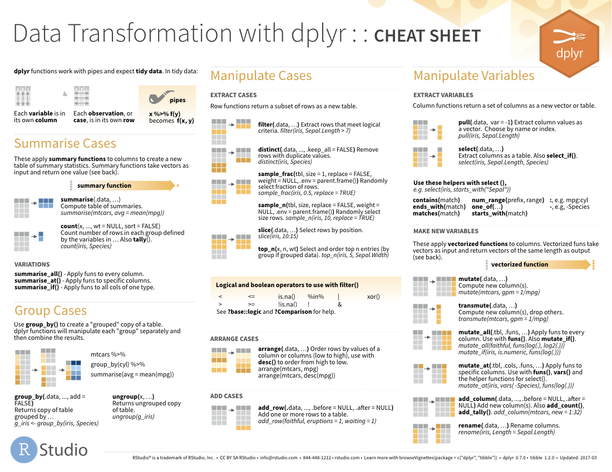
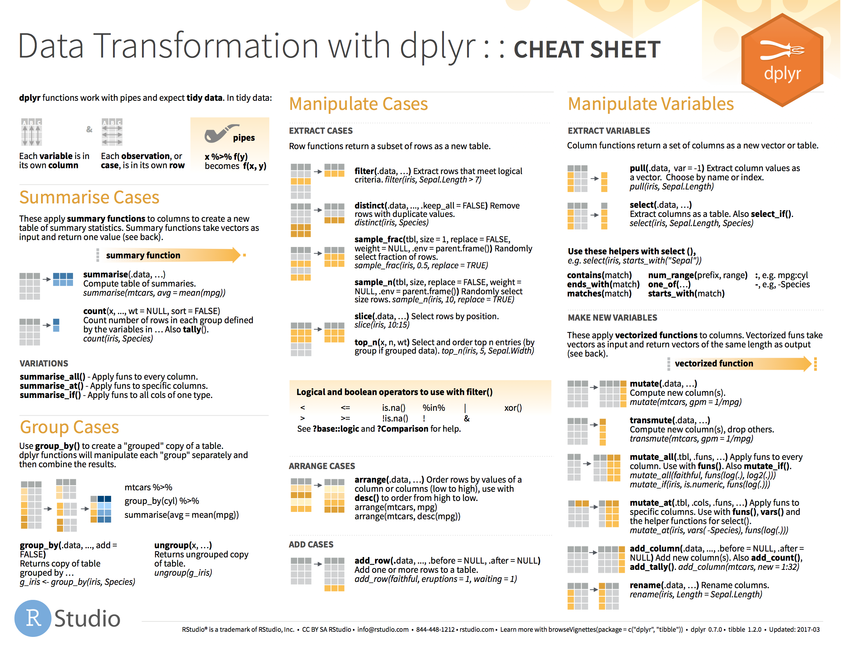
select() helpers
Notes:
I mentioned earlier that select actually has a bunch of helper functions that are there if you want to use a shortcut rather than writing out all the columns you want. So you can do term matching, you can select all columns between two columns, like the third through the tenth.
For a complete list, see the select() section on the dplyr cheatsheet in your appendix

Slide 18
Your Turn 2
Alter the code to select just the first_name column from covid_testing
Use the second code chunk to see if you can remove the first_name column
covid_testing_2 <- select(covid_testing, _____)
Notes:
OK here we go we have another your turn.
For this exercise use the first code chunk to see if you can use the select function to select just the first_name column from the COVID testing data set . Use that second code chunk 2 remove the first_name column.

Slide 19
Subset Specific Rows Based on Logical Conditions

Slide 20
filter()
Extract rows that meet logical criteria
↓ Number of rows
= Number of Columns
Notes:
Here you see the graphical framework for how filter works. You provide the raw data as the input in the form of a data frame.
Filter will use logical criteria that you provide in the function, to identify the rows that are required
In the output, you will wind up with all the columns that you started with and just the rows defined in the filter function.

Slide 21
Common syntax
Each function takes a data frame as its first argument and returns a data frame as its output.
function(data, ...)
dplyr function
data frame to transform
specific arguments
Notes:
Recall that all dplyr functions hew to a common syntax and filter is no exception →

Slide 22
filter()
Extract rows that meet logical criteria
filter(data,... )
one or more logical tests (filter returns each row for which the test is TRUE)
data frame to transform
 |  |  | FALSE
 |  |  | FALSE
 |  |  | TRUE
 |  |  | FALSE
 |  |  | TRUE
 |  |  | FALSE
Notes:
In filter the first argument again is a data frame from which we will be extracting rows.
Afterwards we can input one more logical tests. R then performs that logical test on each row of the dataset and returns all rows in which the logical test is TRUE. Rows for which the tests are TRUE are returned in the output as a data frame and the rest are removed.
The key point here is that the logical tests are evaluated row by row, one at a time, independently.

Slide 23
filter()
Extract rows that meet logical criteria
filter(data, column_name == criteria )
one or more logical tests (filter returns each row for which the test is TRUE)
 |  |  | FALSE
 |  |  | FALSE
 |  |  | TRUE
 |  |  | FALSE
 |  |  | TRUE
 |  |  | FALSE
Notes:
Let's zoom in for a second on those logical tests.
Generally speaking they will take this form.
There will be some column that contains the data you want to filter on, like the clinic name, or the patient MRN.
Then there will be a logical test, what you see here is equals, you can also have greater than, less than etc.
And then you have the criteria. Equal to what? Greater than what number?
OK let's see some real examples →

Slide 24
filter()
Extract rows that meet logical criteria
filter(covid_testing, mrn==5000083)
mrn | first_name | last_name
5000876 | sarella | stark
5006017 | alester | stark
5001412 | jhezane | westerling
5000083 | lollys | clegane
mrn | first_name | last_name
5000083 | lollys | clegane
FALSE
5000876 | sarella | stark
FALSE
5006017 | alester | stark
FALSE
5001412 | jhezane | westerling
TRUE
Notes:
Here's an example. We supply the covid_testing data frame as the first argument. Afterwards we provide one logical test; we ask filter() to return rows in which the mrn is 5000083.
Filter will go row by row, starting from the very first row and ask is the value in the mrn column equal to 500083 for that row, as you can see it's not – so it gets an imaginary value of false. →
It then goes to the second row, again checks to see if the mrn is a match, it's not so it also get's a false.→
And so on for the third →
But in the fourth you can see we do have a match – so that gets a TRUE. →
So the output of this function is a data frame with the same number of columns but only the rows that resulted in a TRUE based on the criteria in the function

Slide 25
filter()
Extract rows that meet logical criteria
filter(covid_testing, mrn==5000083)
mrn | first_name | last_name
5000876 | sarella | stark
5006017 | alester | stark
5001412 | jhezane | westerling
5000083 | lollys | clegane
= sets
(returns nothing)
== tests if equal
(returns TRUE or FALSE)
data frame to transform
Notes:
Note that I used double equals inside of the logical test. Double equals means: compare the left hand to the right hand sides and if it’s the same, then return TRUE. The double equals is called the comparison operator. In contrast, a single equals sign sets a variable (the left side) to a value (usually on the right). It is a very common mistake to accidentally use a single equals inside of the filter function, which will result in an error.

Slide 26
filter()
Values coded as character strings must be surrounded by quotes
Extract rows that meet logical criteria.
filter(covid_testing, last_name=="stark")
mrn | first_name | last_name
5000876 | sarella | stark
5006017 | alester | stark
5001412 | jhezane | westerling
5000083 | lollys | clegane
mrn | first_name | last_name
5000876 | sarella | stark
5006017 | alester | stark
TRUE
TRUE
FALSE
FALSE
Notes:
Similarly we can ask filter to return just the rows that represent tests for a specific patient, like stark.
In this case the first two rows result in TRUE and so are kept
Note that when asking filter to return rows with specific text inside of it, we have to put that text in quotes and it's got to be an exact match, partial matches don't count.

Slide 27
filter()
Extract rows that meet logical criteria
filter(data,... )
one or more logical tests (filter returns each row for which the test is TRUE)
data frame to transform
Notes:
So what we've seen is that the output of a filter() function is completely dependent on the logical operators in this green rectangle. Rows in which the logical statement results in a TRUE are returned and those that are FALSE will not be returned. So the next question of course is how do you construct logical statements in R.

Slide 28
Logical tests
x < y | Less than
x > y | Greater than
x == y | Equal to
x <= y | Less than or equal to
x >= y | Greater than or equal to
x != y | Not equal to
x %in% y | Group membership
is.na(x) | Is NA
!is.na(x) | Is not NA
Notes:
R provides logical operators for every occasion. Here are just some of the important logical operators to know about.
We’ve already seen the double equals. Theres also the less than or and greater than operators. These each also come as “or equal to” versions.
Use exclamation point-equals (!=) if you want to select rows in which a value is not equal to something else.
There are more here that we won't get into at the moment.

Slide 29
Pop Quiz
What is the result?
1 == 1
Notes:
Alright POP QUIZ, let's see if we can predict what R will say
If we type into the console 1 ==1, what is the output from R? put your answer in the chat
R will output a TRUE

Slide 30
Pop Quiz
What is the result?
3 != 1
Notes:
How about this, if we type 3 != 1, will we get a TRUE or a FALSE
Let's try it in our Rstudio console
This is TRUE as well

Slide 31
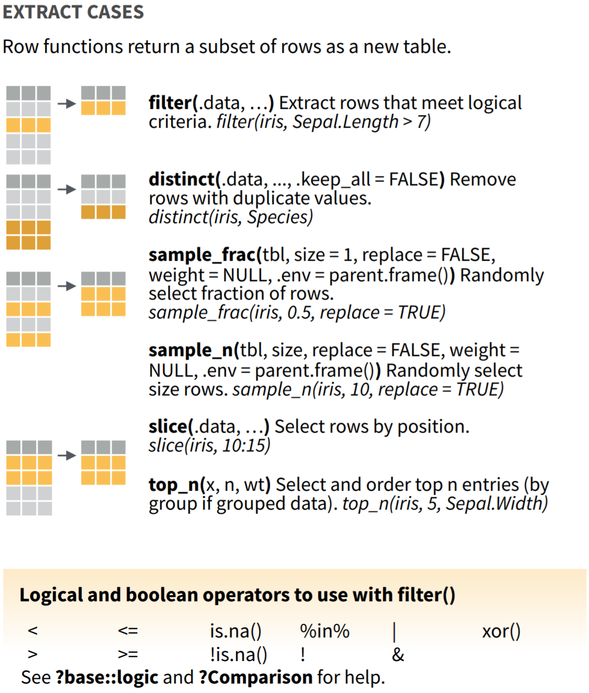
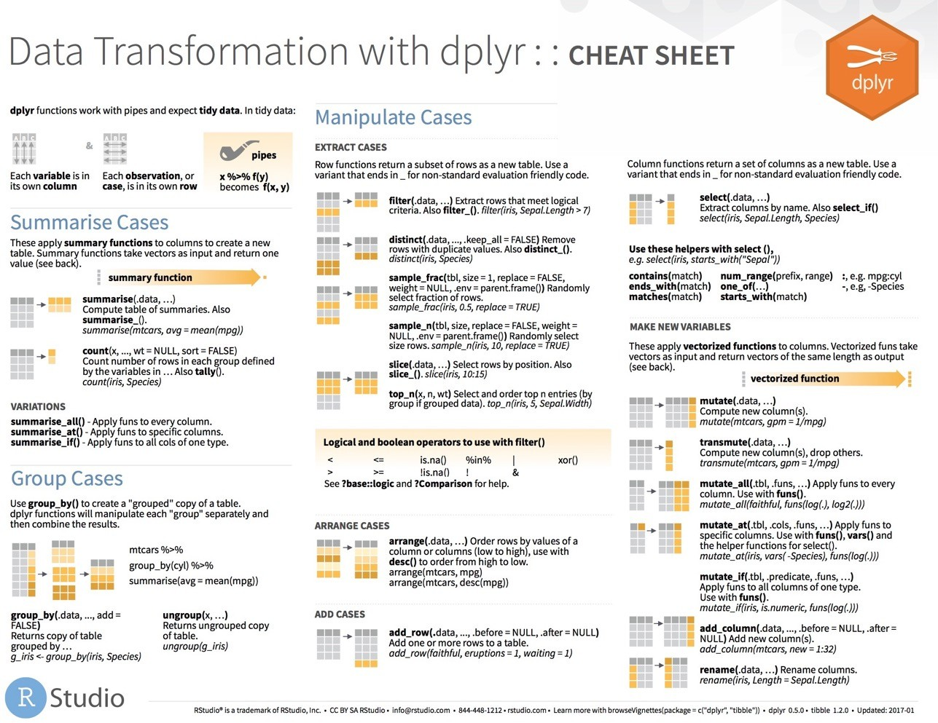
filter() variants
Notes:
Now filter() is only one of many functions that dplyr provides to allow you to extract the rows you want from your data. For a more comprehensive sampling see the Manipulate cases section on the dplyr cheatsheet.

Slide 32
Your Turn 3
Use filter() with the logical operators to find:
Every test for patients over age 80
All of the covid testing where the demographic group (demo_group) is equal to "client"
Notes:
OK so why don’t we try to put this into action. Shift over to Rstudio cloud, go to Your Turn 3 in the rmarkdown document and work through the exercise

Slide 33
Recap
dplyr is a package that contains a variety of data transformation packages intended to be used sequentially
select() will extract specific columns from a data frame
filter() extracts specific rows from a data frame based on logical conditions, and evaluates each row to determine if it is retained or removed

Slide 34
What else?

Slide 35
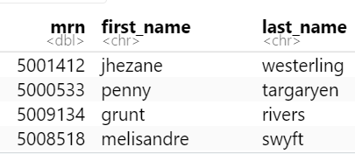
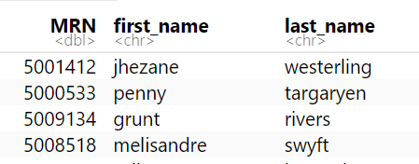
select()
Renaming columns
covid_testing %>%
select(MRN = mrn, first_name, last_name)

Slide 36
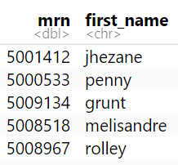
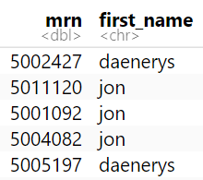
filter()
Filter to multiple matches
covid_testing %>%
filter(first_name %in% c("jon","daenerys"))

Slide 37
Goal
Learn how to use dplyr to transform data frames
Create a smaller subset from a data frame
Objectives
List the major forms of data transformation implemented in dplyr
Use code templates with dplyr functions to tidy a raw data set
Create a subset using logical conditions to extract specific rows from a data frame
Notes:
Our goals for this session are to learn to use some of the functions in the dplyr package to tackle some of the most common challenges in data transformation. In addition we'll be using a special tool called a pipe operator to string together individual functions into a data analysis pipeline.

